Slide 1
MEDICARE PROVIDERS DATA WAREHOUSE
Data Warehousing & Business Intelligence
TEAM – 02
DATA WIZARDS
Submitted By:
DARSHAN DURVE - 001898887
MANYA RAMAN - 001497103
ADITYA PRASAD - 001476343
VEDANT PEDNEKAR - 001434737

Slide 2
OBJECTIVES
To create a dynamic data warehouse using ETL processes in order to create business intelligence dashboards related to healthcare provider information
To analyze the amount the provider pays and the connection between the calculation of costs for medical procedures in different medical centers based on beneficiary conditions.
To analyze state-wise suppliers and their average payment info depending on the Durable Medical Equipment, Prosthetics, Orthotics and Supplies provided.
Comparing the cost of medical procedures in each center with respect to the average cost for each condition.
Comparing the cost of medical equipment in each medical center with respect to the national average.
Other ad-hoc analysis reports based on requirements.

Slide 3
DATASETS OVERVIEW
All the datasets we selected and are described below are for multiple years from 2015 to 2017.
The Medicare Physician and Other Supplier National Provider Identifier (NPI) Aggregate Report - It contains 1.09million rows and 70 columns which includes data of all the healthcare providers of the nation. This also provides us with the exact amount each provider charged for their benefactors and the amount that was covered by Medicare and the actual amount paid by the patients which is extremely crucial for our analysis
https://data.cms.gov/Medicare-Physician-Supplier/Medicare-Physician-and-Other-Supplier-National-Pro/n5qc-ua94
Medicare Referring DMEPOS HCPCS State Aggregate table - DMEPOS is short for Durable Medical Equipment, Prosthetics, Orthotics and Supplies. This dataset provides a comprehensive description of the DMEPOS product and services provided to Medicare beneficiaries ordered by physicians and other healthcare professionals. It proves to be useful by providing us with the average supplier payment amount and the average allowed Medicare amount categorized by state and DMEPOS product or service. This data set contains 40k rows and 15 columns as shown below:
https://data.cms.gov/Medicare-Durable-Medical-Equipment-DME-/Medicare-Referring-DMEPOS-HCPCS-State-Aggregate-ta/kpkt-855d

Slide 4
State Summary of Inpatient Charge Data- The Inpatient PUF includes information on utilization, payment (total payment and Medicare payment), and hospital-specific charges for the more than 3,000 U.S. hospitals that receive Medicare Inpatient Prospective Payment System (IPPS) payments. Each row is described as a drug per state. It consists of 27.5k rows and 6 columns.This dataset was used to obtain the DRG information a classification system which groups patients with similar conditions. The entire dataset can be found below:
https://data.cms.gov/Medicare-Inpatient/State-Summary-of-Inpatient-Charge-Data-by-Medicare/q5hc-zvkx
Medicare Provider Utilization and Payment Data - This dataset provides details on services and procedures provided to Medicare beneficiaries by physicians and other healthcare professionals. This data set allows users to find out the average number of beneficiaries under each health care practitioner and the cost charged by each provide along with the amount covered by Medicare per HCPCS code. This data is extremely comprehensive consisting of 9.85 million rows and 25 columns. The entire data set can be seen below:
https://data.cms.gov/Medicare-Physician-Supplier/Medicare-Provider-Utilization-and-Payment-Data-Phy/fs4p-t5eq

Slide 5
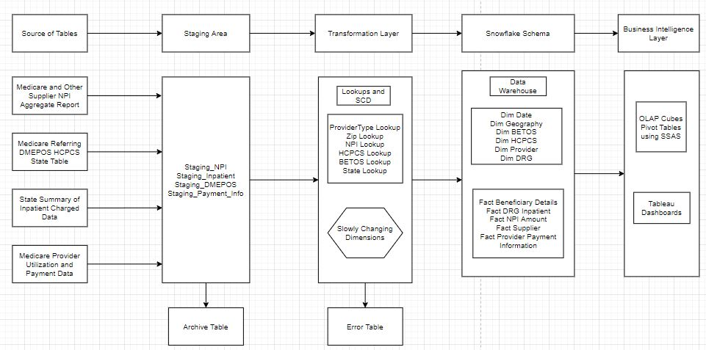
DATA-FLOW DIAGRAM

Slide 6
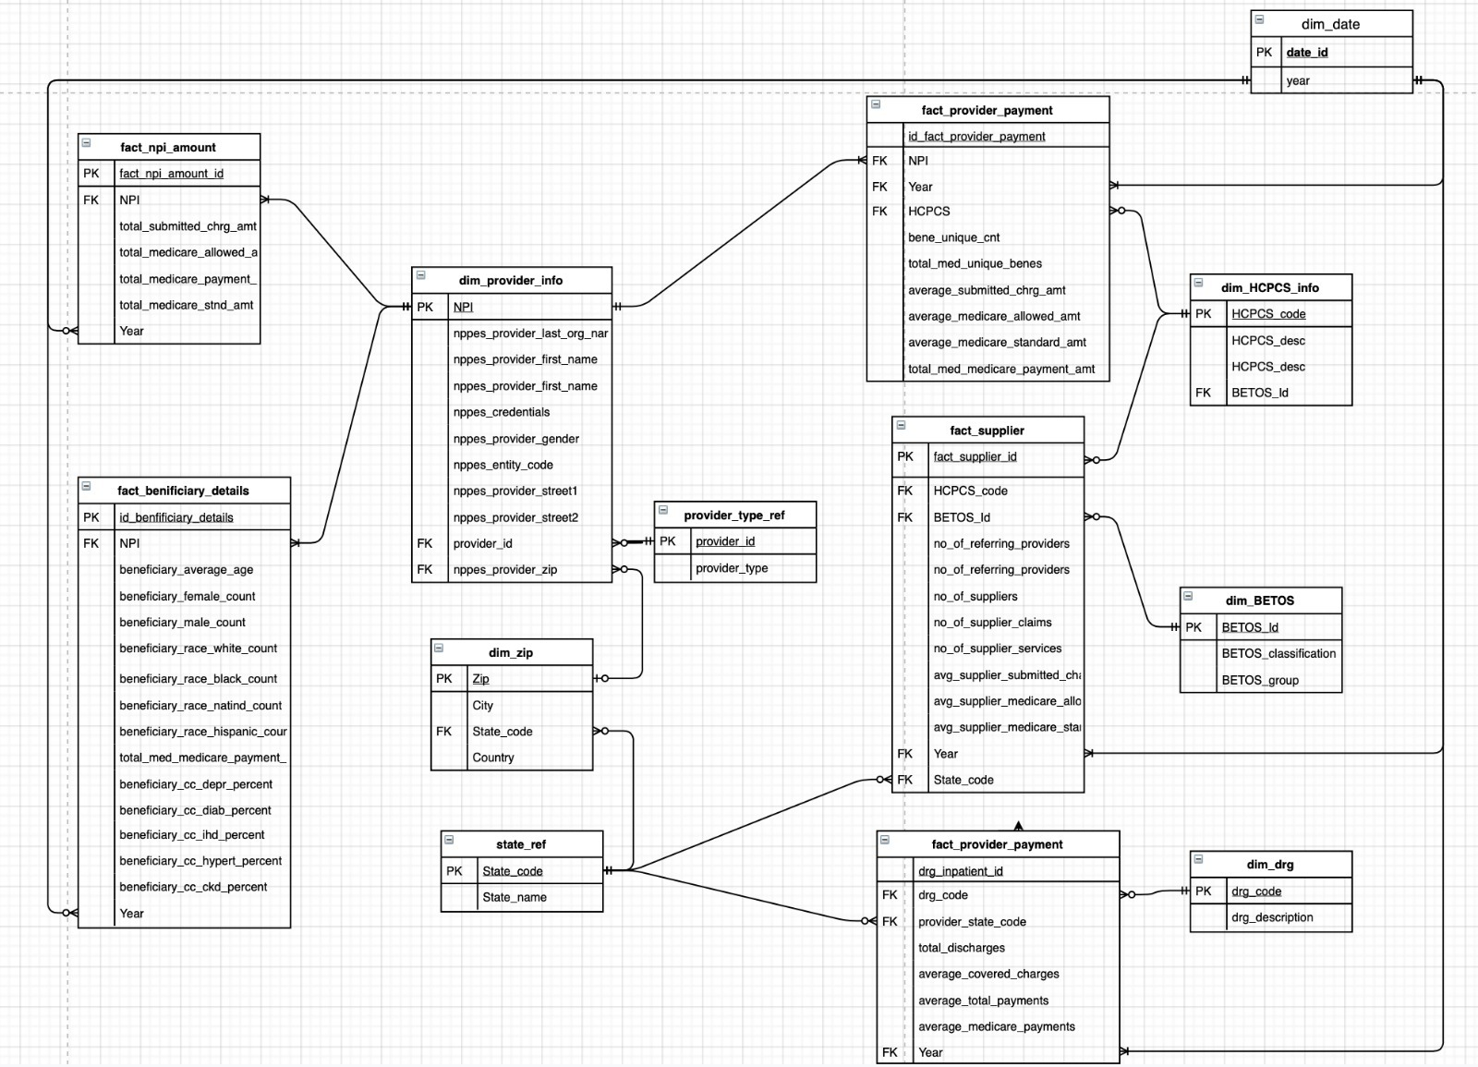
ER Model

Slide 7
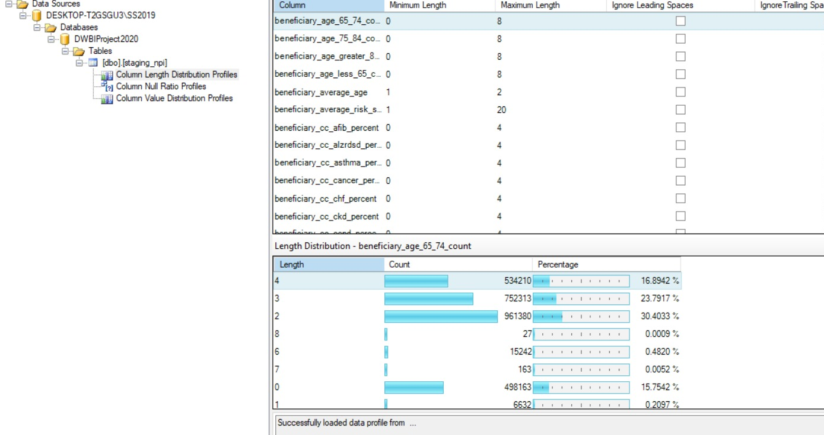
DATA PROFILING
Measures:
Column Length
Null Ratio
Distinct values

Slide 8
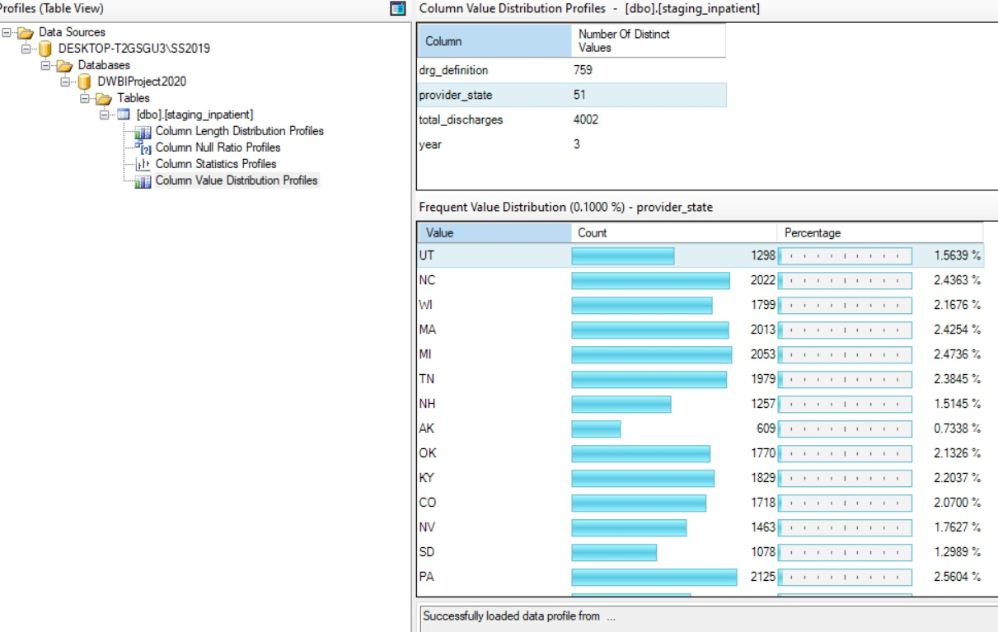

Slide 9
ELT
First, we gathered all the 5 datasets files for 3 years (2015, 2016 and 2017) in csv format.
Created folder for all relevant data-sets and loaded all the files using for each loop containers in SSIS to staging tables.
This process allowed us to add a new column for the year to each dataset when it was being loaded into SQL Server. This was done using the derived column option in SSIS as shown below.

Slide 10
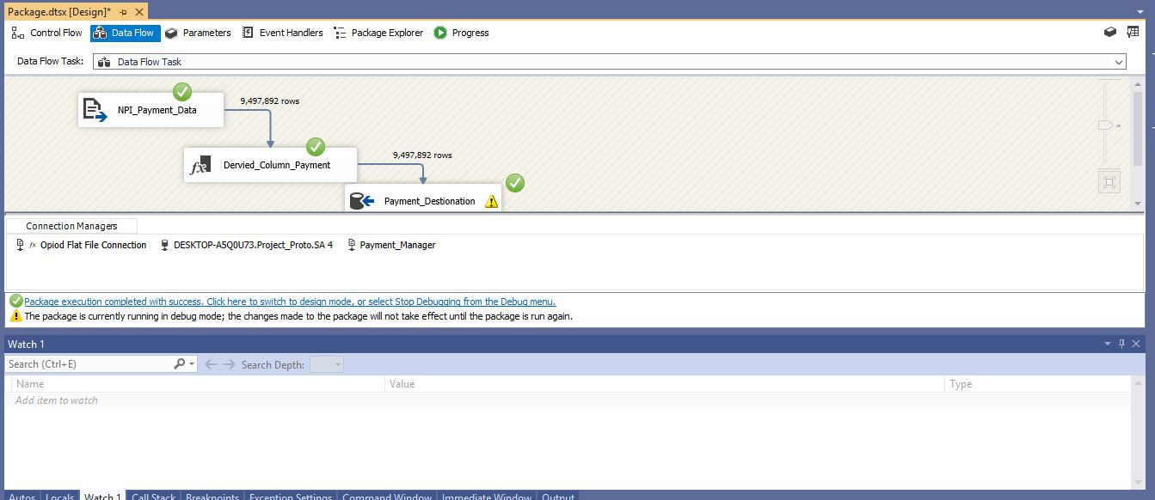
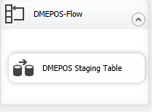
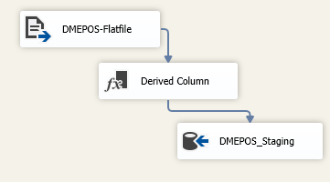
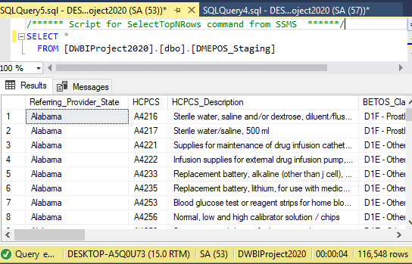
FOR-EACH LOOP FOR STAGING

Slide 11
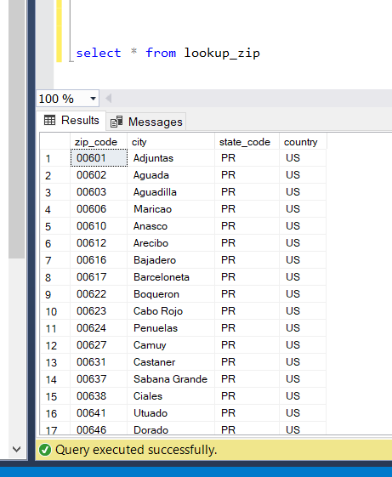
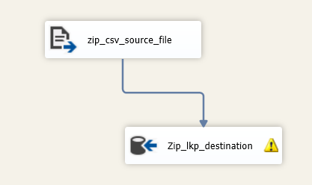

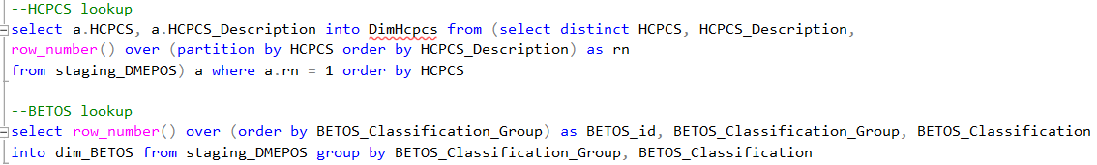
LOOKUPS AND VALIDATION
staging_payment_info
staging_DMEPOS

Slide 12
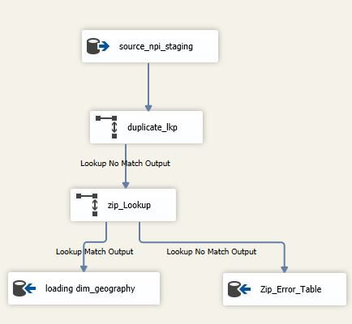
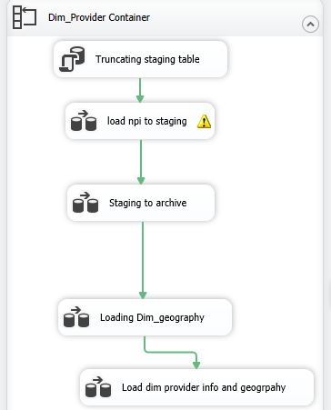
Transformations:
Four tables were created from NPI_Staging:
Dim Geography
Dim Provider
Fact Beneficiary Info
Fact Amount Info
Loading Dim Geography
For each loop container

Slide 13
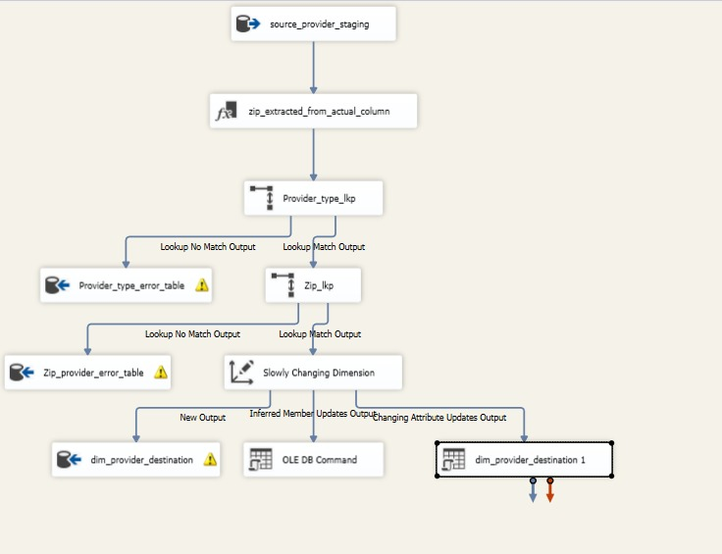
SCD Process

Slide 14
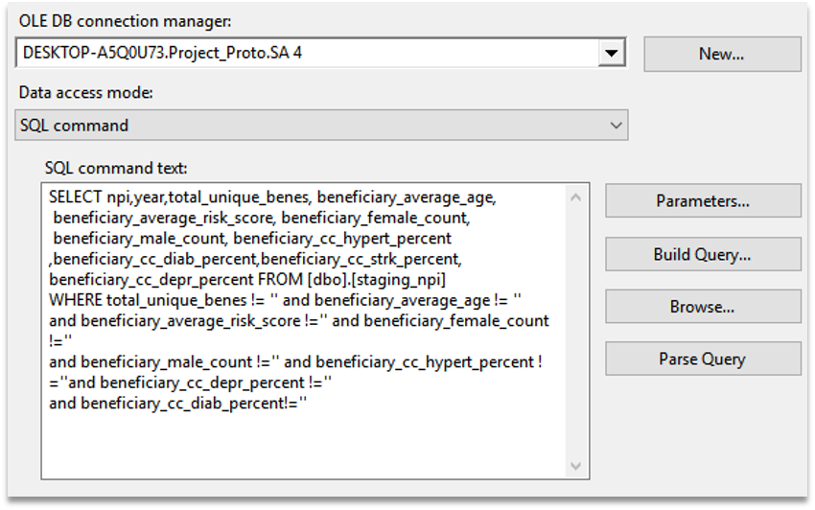
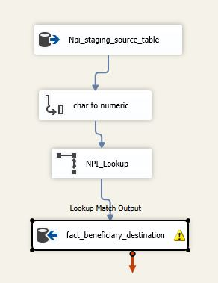
Data Cleaning :
Char to numeric char to numeric with precision and scale.
Taking rows which have data which were around 75% records from 3 million.

Slide 15
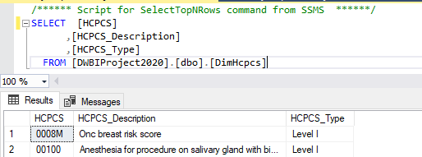
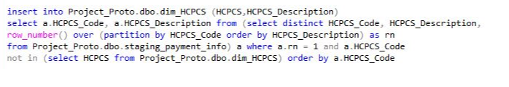
DIM HCPCS
This table was created to contain unique HCPCS from the DMEPOS State dataset and NPI Payment Dataset which acted as a look up while creating other tables.
We also classified HCPCS into 2 levels:
Level I : These are 5-position numeric codes representing physician and non-physician services.
Level II : These are 5-position alpha-numeric codes comprising the D series, primarily include non-physician services such as ambulance services and prosthetic devices, and represent items and supplies and non-physician services, not covered by CPT-4 codes (Level I). (All the DMEPOS codes are type II)

Slide 16
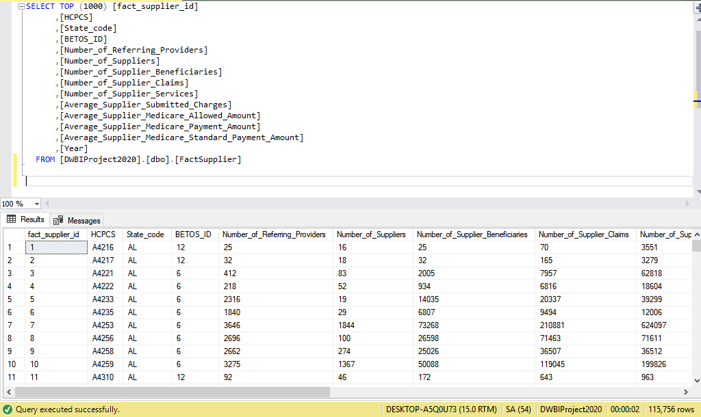
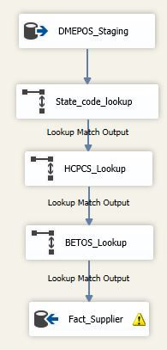
FACT SUPPLIER ETL
Lookups:
The state lookup is used to validate state and load state code instead of full state name.
The HCPCS lookup is used in order to ensure HCPCS is validated.
The BETOS lookup is used to validate BETOS Classification and get BETOS Id in place of BETOS classification.

Slide 17
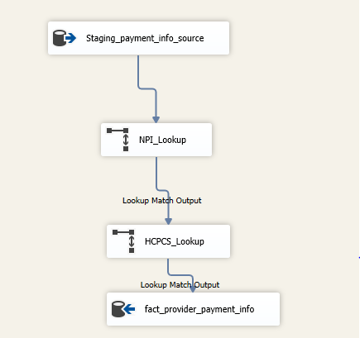
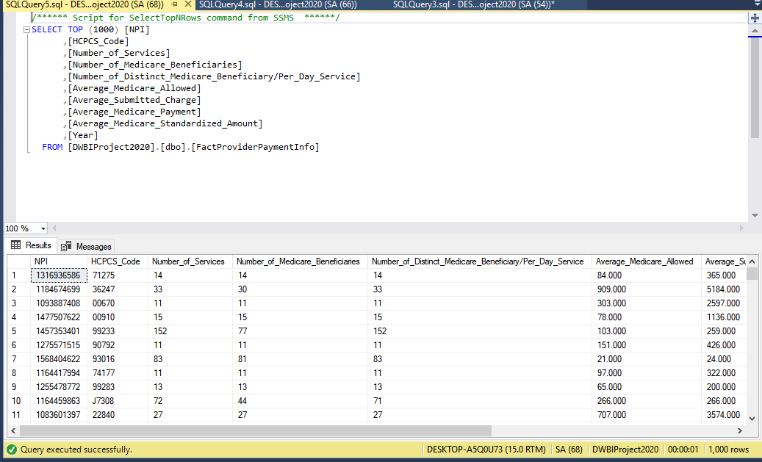
FACT PROVIDER PAYMENT INFO

Slide 18
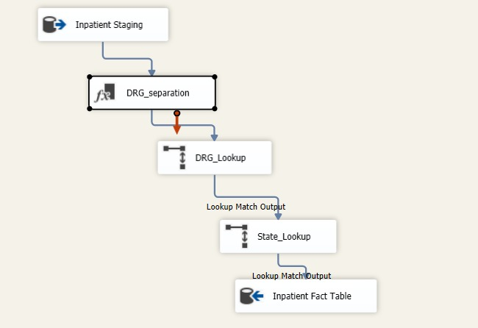
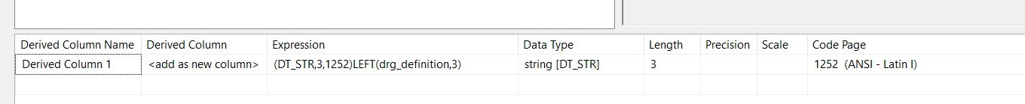
Inpatient DGR INFO
The column drg in the staging was a mix of both drg code as well as description.
We created the lookup by dividing the column into code and description and as some descriptions were a little different for same code we took only one.
Since the data loaded into staging in have a mix column we generated the code in Drg_seleperation block.
Then used the lookups to load to destination.

Slide 19
FOREIGN KEY RELATIONSHIPS
Once all the data was loaded we were able to finish with the load process by defining foreign key relationships to each table.
The various relationships are as follows :
Dim Provider – Provider Id and Provider Zip
Fact Supplier- State Code, HCPCS Code and BETOS Id
Fact Beneficiary Details – NPI
Fact Provider Payment – HCPCS
Dim HCPCS – BETOS Id
Dim Geography – State Code
These relationships were created using alter table commands in SQL Server

Slide 20
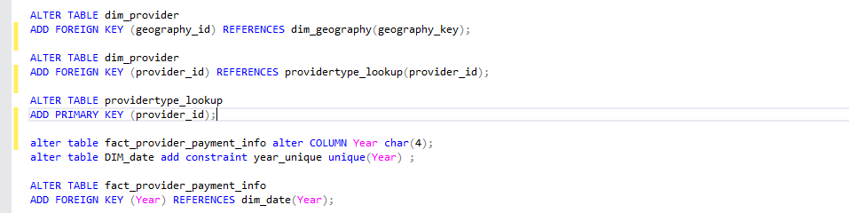
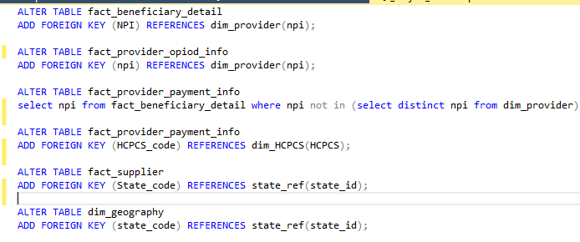
FOREIGN KEY RELATIONSHIPS

Slide 21
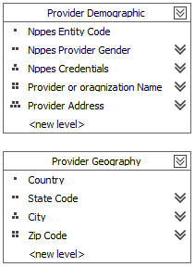
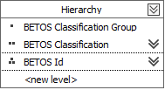
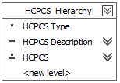
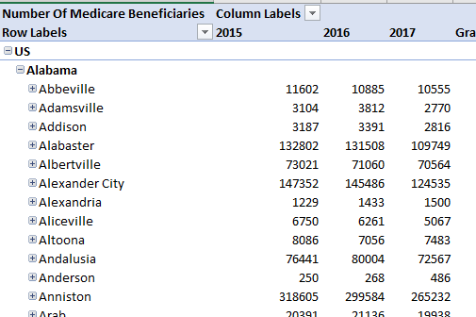
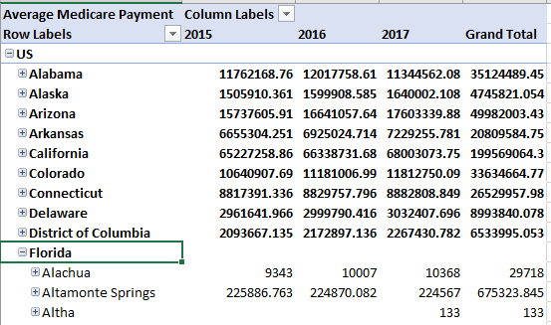
SSAS – OLAP CUBES DESIGN

Slide 22
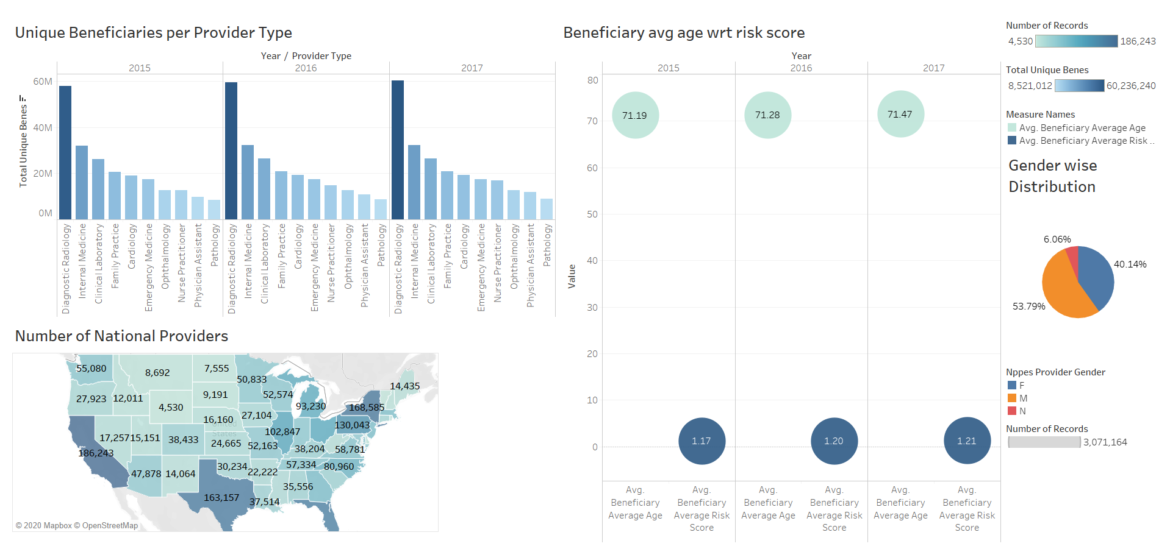
BUSINESS INTELLIGENCE DASHBOARDS- TABLEAU

Slide 23
INSIGHTS
Diagnostic Radiology has the most consistent Unique consumers over the years for all US states
Average Beneficiary Age of all Providers Average Risk score proportionally
California #1 in terms of total payments for diseases paid by the Insurance Companies
Max # of Supplier Services involve Albuterol and the highest # of suppliers service to California
For the type 2 services - Blood glucose test #1 supplied equipment by the suppliers prescribed by the maximum number of healthcare providers. It had the beneficiary count ~ 3,470,023 in 2015 which lowered down to 2,901,900 in 2017
For the type 1 services - Outpatient visit (typically 15 mins) had the most number of beneficiaries all the years combined, followed by outpatient visit (25 mins) and Needle insertion for blood sample category

Slide 24
RESULTS
Health care providers and the companies have invested the most in sectors - Diagnostic Radiology,
Internal Medicine and Clinical Laboratory with regards to insurance plans
The best coverage is received by beneficiaries residing in New Jersey state
Suppliers & medical manufacturers supplying glucose test equipment are making the most money
Consumers are likely to invest in Healthcare plans involving Outpatient visits and blood test labs
Overall, this warehouse digs deep and provides strategies as to how to grow the insurance business as well provide the consumers with dynamic view about the best plans to invest in & most optimal medical centers to visit for each chronic conditions

Slide 25
THANK YOU !!

Slide 26
QUESTIONS ?

